Slide 1
Object Oriented Programming CS F213

Slide 2
Contents
Event
Event Handling
Delegation Event Model
Important Events and Listeners
Swing
Swing Hierarchy
Common methods from Component Class
Swings Classe: JFrame
Examples
Sources (Slide 3 to 11):
https://www.javatpoint.com/java-swing
https://cse.iitkgp.ac.in/~dsamanta/java/ch10.htm
https://www.studytonight.com/java/java-swing.php

Slide 3
Event
Change in the state of an object is known as Event, i.e., event describes the change in the state of the source.
Events are generated as a result of user interaction with the graphical user interface components.
Typical examples are:
Mouse movements
Mouse clicks
Hitting any key
Hitting return key
etc.
Telling the GUI what to do when a particular event occurs is the role of the event handler.

Slide 4
Event Handling
Event Handling is the mechanism that controls the event and decides what should happen if an event occurs.
This mechanism has a code which is known as an event handler, that is executed when an event occurs.
Java uses the Delegation Event Model to handle the events.

Slide 5
Delegation event model
The Delegation Event Model has the following key participants.
Source
The source is an object on which the event occurs.
Source is responsible for providing information of the occurred event to it's handler.
Java provide us with classes for the source object.
Listener
It is also known as event handler.
The listener is responsible for generating a response to an event.
From the point of view of Java implementation, the listener is also an object.
The listener waits till it receives an event. Once the event is received, the listener processes the event and then returns.
The benefit of this approach is that the user interface logic is completely separated from the logic that generates the event.
In this model, the listener needs to be registered with the source object so that the listener can receive the event notification.

Slide 6
Important Events and Listeners
Events are supported by a number of Java packages,like java.util, java.awt and java.awt.event.
Event Classes | Description | Listener Interface
ActionEvent | generated when button is pressed, menu-item is selected, list-item is double clicked | ActionListener
MouseEvent | generated when mouse is dragged, moved,clicked,pressed or released and also when it enters or exit a component | MouseListener
KeyEvent | generated when input is received from keyboard | KeyListener
ItemEvent | generated when check-box or list item is clicked | ItemListener
TextEvent | generated when value of textarea or textfield is changed | TextListener

Slide 7
Important Events and Listeners
Event Classes | Description | Listener Interface
MouseWheelEvent | generated when mouse wheel is moved | MouseWheelListener
WindowEvent | generated when window is activated, deactivated, deiconified, iconified, opened or closed | WindowListener
ComponentEvent | generated when component is hidden, moved, resized or set visible | ComponentEventListener
ContainerEvent | generated when component is added or removed from container | ContainerListener
AdjustmentEvent | generated when scroll bar is manipulated | AdjustmentListener
FocusEvent | generated when component gains or loses keyboard focus | FocusListener

Slide 8
Swing
Java Swing is a part of Java Foundation Classes (JFC) that is used to create window-based applications.
Java Swing components are platform independent.
It is built on the top of AWT (Abstract Windowing Toolkit) API and entirely written in Java.
Java Swing provides better lightweight components than AWT.
The javax.swing package provides classes for Java Swing components such as JButton, JTextField, JTextArea, JRadioButton, JCheckbox, JMenu, JColorChooser etc.

Slide 9
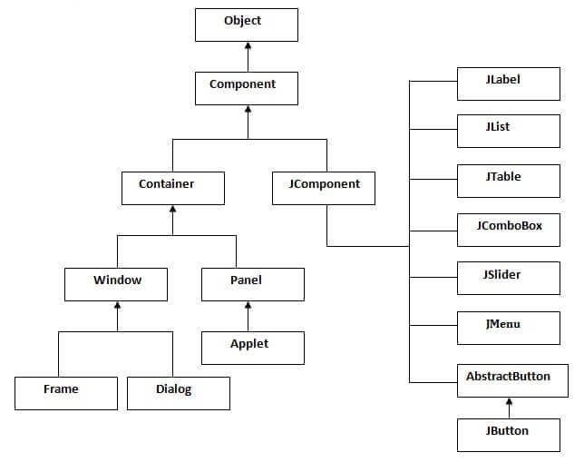
Swing Hierarchy

Slide 10
Common methods from Component Class
Method | Description
public void add(Component c) | add a component on another component.
public void setSize(int width,int height) | sets size of the component.
public void setLayout(LayoutManager m) | sets the layout manager for the component.
public void setVisible(boolean b) | sets the visibility of the component. It is by default false.

Slide 11
Swings Classes: JFrame
There are two ways to create a JFrame Window.
By instantiating JFrame class.
By extending JFrame class.
Example 1 (by Instantiating JFrame class)
Example 2 (by extending JFrame class)

Slide 12
Thank you.

